Slide 1
​Multi Object Recognition for Visually-Impaired People Using Machine Learning
Title Slide
DRC-1
Area/ Specialization: Machine Learning
Project Type: Academic Main project
BATCH-No 32
Project Guide : ​Mr.​ B.Vamsi
REGISTER NUMBERS | NAME OF STUDENTS | NO OF MEETINGS WITH GUIDE
16L31A05E4 16L31A05E7 16L31A05H5 16L31A05C7 | K.V.K VARMA BOMMALI SNEHASHISH S.V.S RAMESH CH.B.V PRAVEEN | 25 25 23 10
DEPARTMENT OF CSE

Slide 2
Motivation/Origin
DRC-1
In everyday life, we have come across many people who are visually impaired. They are not able to see the things which are in front of them.
So, we decided to provide them a solution by building a system which can help them by detecting the multiple objects around them and tells them the particular object which is in front of them.
Now our Work is to develop a model which would able to solve blind people vision problems.
DEPARTMENT OF CSE

Slide 3
Motivation/Origin
DRC-1
PROBLEM STATEMENT:
Visual information is the basis for most navigational task, So visually impaired people are at disadvantage because necessary information about the surrounding environment is not available. Without vision it can be challenging for a visually impaired person to navigate through a room or hallway without bumping into obstacles.
ABSTRACT:
This project presents a new technique for assisting visually-impaired people in recognizing objects in environment. The existing methodologies which aims to solve the problem of object recognition in a traditional way with a single-label strategy. By using machine learning and vision technologies, our work is to provide an efficient solutions for assisting visually-impaired people with a multi-label strategy. In the proposed work we are solving the existing system problem by using classification . The model used to assist the visually impaired people can independently recognize objects which are near to them.
DEPARTMENT OF CSE

Slide 4
Motivation/Origin
EXISTING SYSTEM:
Rim Trabelsi, Issam Jabri et al. (2018) has proposed their work on “Indoor Object Recognization in RGBD images with complex –Valued Neural Networks for Visually-impaired people” to recognize a single object with an accuracy of 79%.
PROPOSED SYSTEM:
Now our work aims at solving Multi Object Detection problem where we detect multiple kinds of Objects in a single Image which includes Objects not only present in the indoor but also the objects which are present in the outdoor also using Retina-Net.
The dataset which we included contains 80 different objects collected from COCO dataset and those 80 class labels can be viewed in the next slide.
DEPARTMENT OF CSE

Slide 5
DATASET used & Class Labels
actual_labels =
[
"person", "bicycle", "car", "motorcycle", "airplane",
"bus", "train", "truck", "boat", "traffic light", "fire hydrant", "stop sign",
"parking meter", "bench", "bird", "cat", "dog", "horse", "sheep", "cow", "elephant", "bear",
"zebra", "giraffe", "backpack", "umbrella", "handbag", "tie", "suitcase", "frisbee", "skis",
"snowboard", "sports ball", "kite", "baseball bat", "baseball glove", "skateboard", "surfboard",
"tennis racket", "bottle", "wine glass", "cup", "fork", "knife", "spoon", "bowl", "banana", "apple",
"sandwich", "broccoli", "carrot", "hot dog", "pizza", "donut", "cake", "chair", "couch", "orange",
"potted plant", "dining table", "toilet", "tv", "laptop", "mouse", "remote", "keyboard", "cell phone",
"bed","microwave", "oven", "toaster", "sink", "refrigerator", "book", "clock", "vase", "scissors", "teddy bear","hair dryer", "toothbrush”
]
The above mentioned are 80 different class labels (objects) used for Training our model..
Training Data was taken from COCO – dataset 2014 .
Notes:
The above mentioned are 80 different class labels (objects) used for Training.. Training Data was taken from COCO – dataset 2014 .

Slide 6
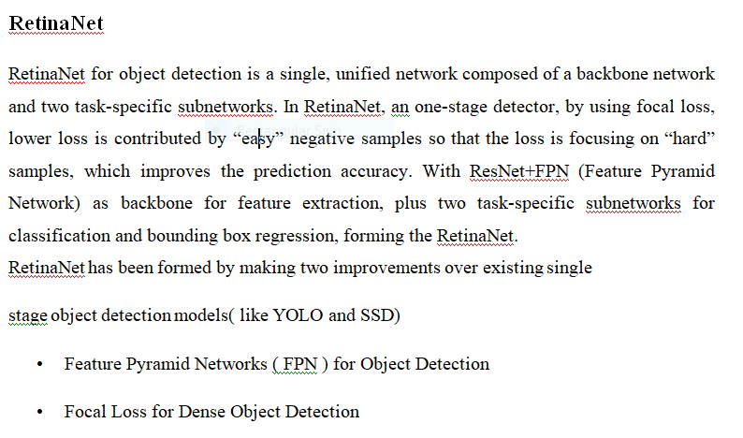
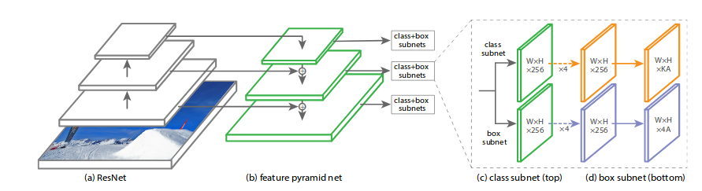
Algorithm

Slide 7
Pre-Requirements for Project
To perform object detection using ImageAI ,you need to install all the required packages.
Download Python 3
Install ImageAI and dependencies.
Install Tensorflow (version = 2.15.0)
Install OpenCV
Install Keras
Python GTTS(Google Text To Speech)
UI development is done using Python TKINTER module
Tkinter widgets
Button
Menu
Frame
Label

Slide 8
Hardware & Software Requirements
Hardware Requirement
Processor ---- Pentium-IV 3.5GHz
RAM ---- 4 GB(min)
Hard Disk ---- 40GB
Input Device ---- Standard Windows Keyboard, Mouse, mobile phone with camera
Output Device ---- Monitor, speakers
Software Requirement
Operating System | Windows XP or Later Version
Database | System storage
Language | Python

Slide 9
Graphical Abstract
Blind Person
Image Store/Gallery
Pre-processing
Classification
Face Data
Object Data
Multi Object Classification
Voice Output of the Object/Face
Algorithm

Slide 10
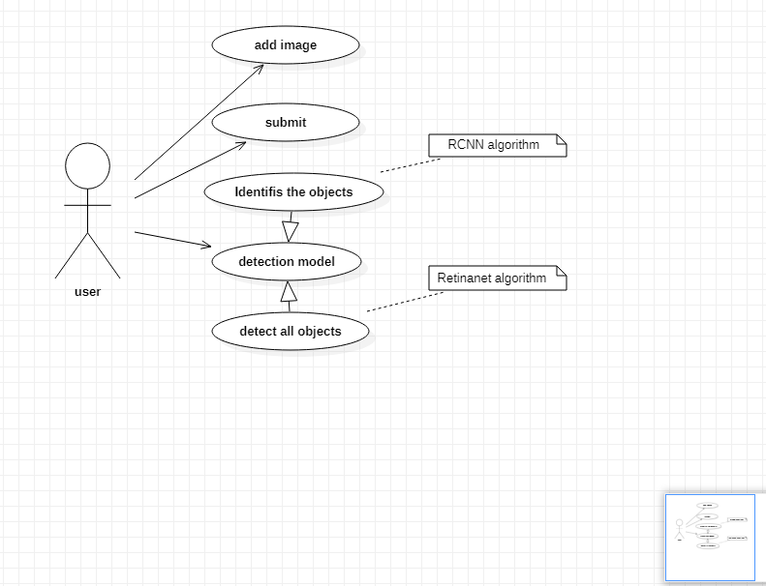
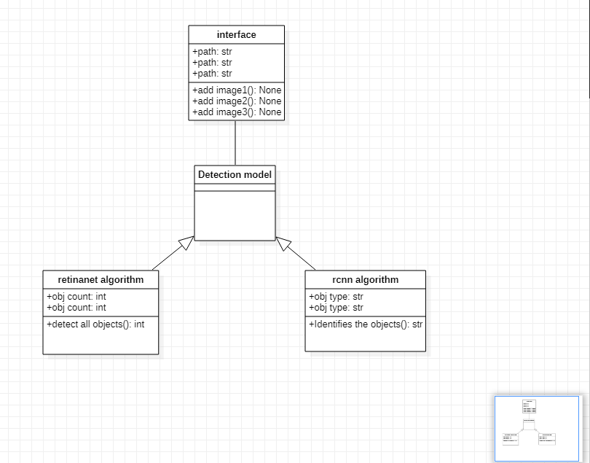
Graphical work flow ( Uml diag)
Class Diagram
Use case Diagram

Slide 11
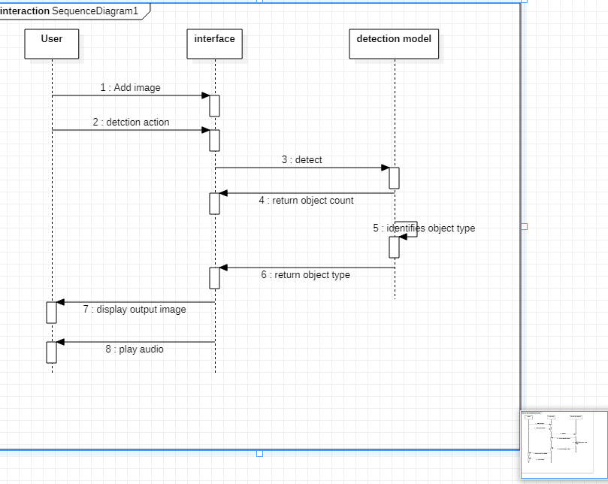
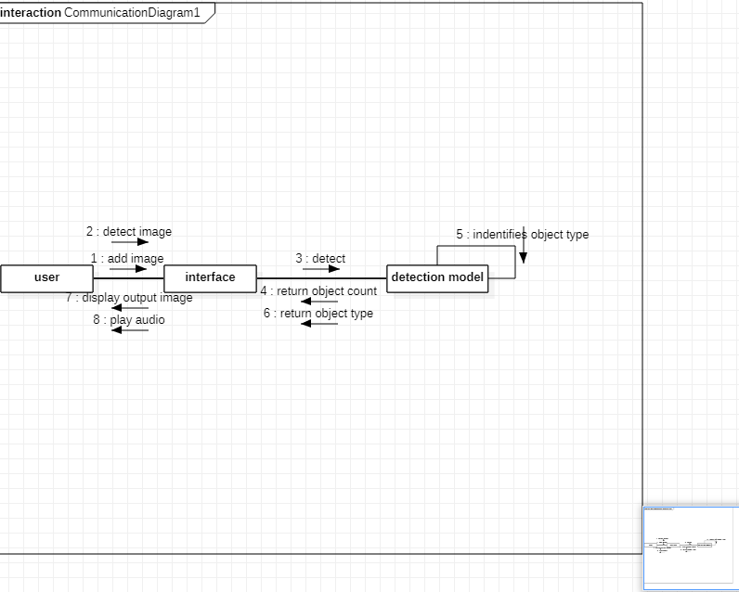
Graphical work flow ( Uml diag)
Sequence diagram
Colloboration diagram

Slide 12
Output

Slide 13
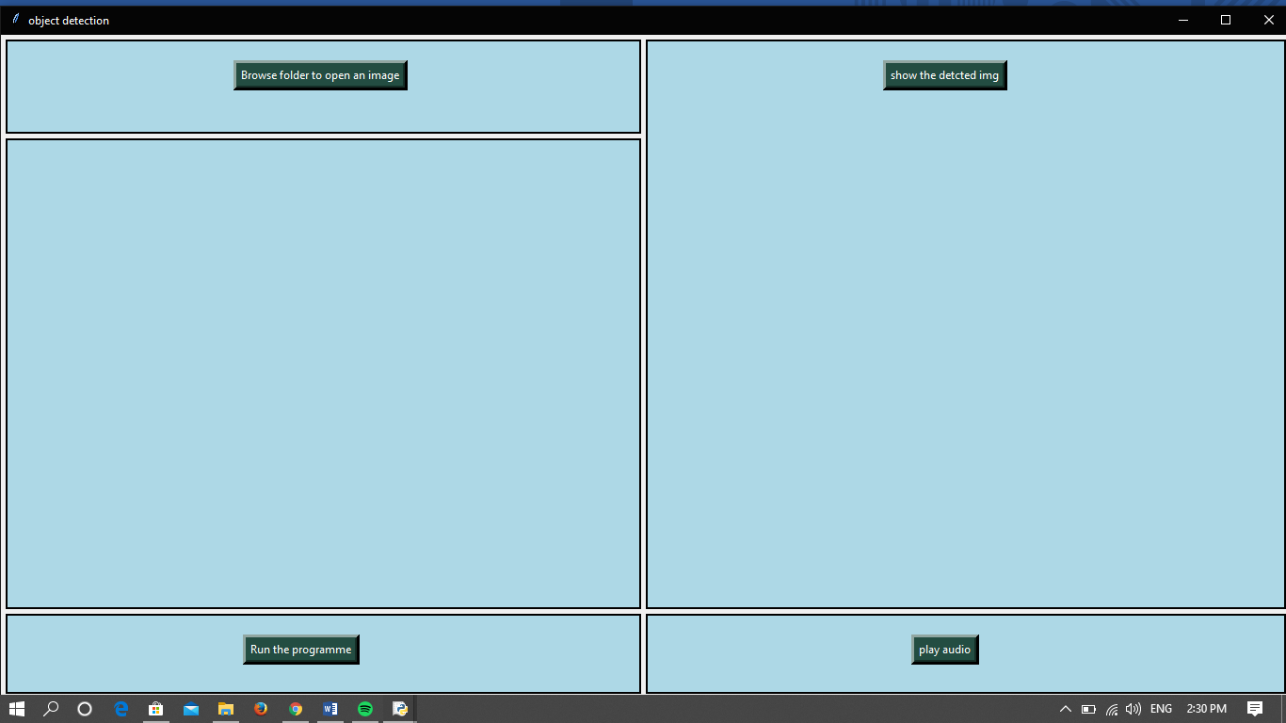
Home Screen

Slide 14
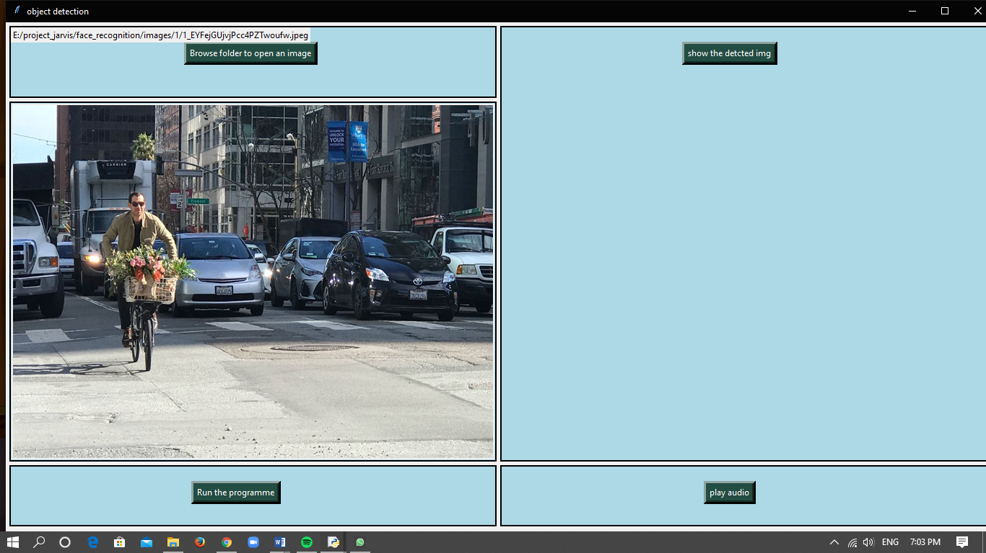
Dispalying Input-Image
Notes:
Now when the User clicks the button “ Run the Progamme” the output image gets displayed on “Show the detected img” frame.

Slide 15
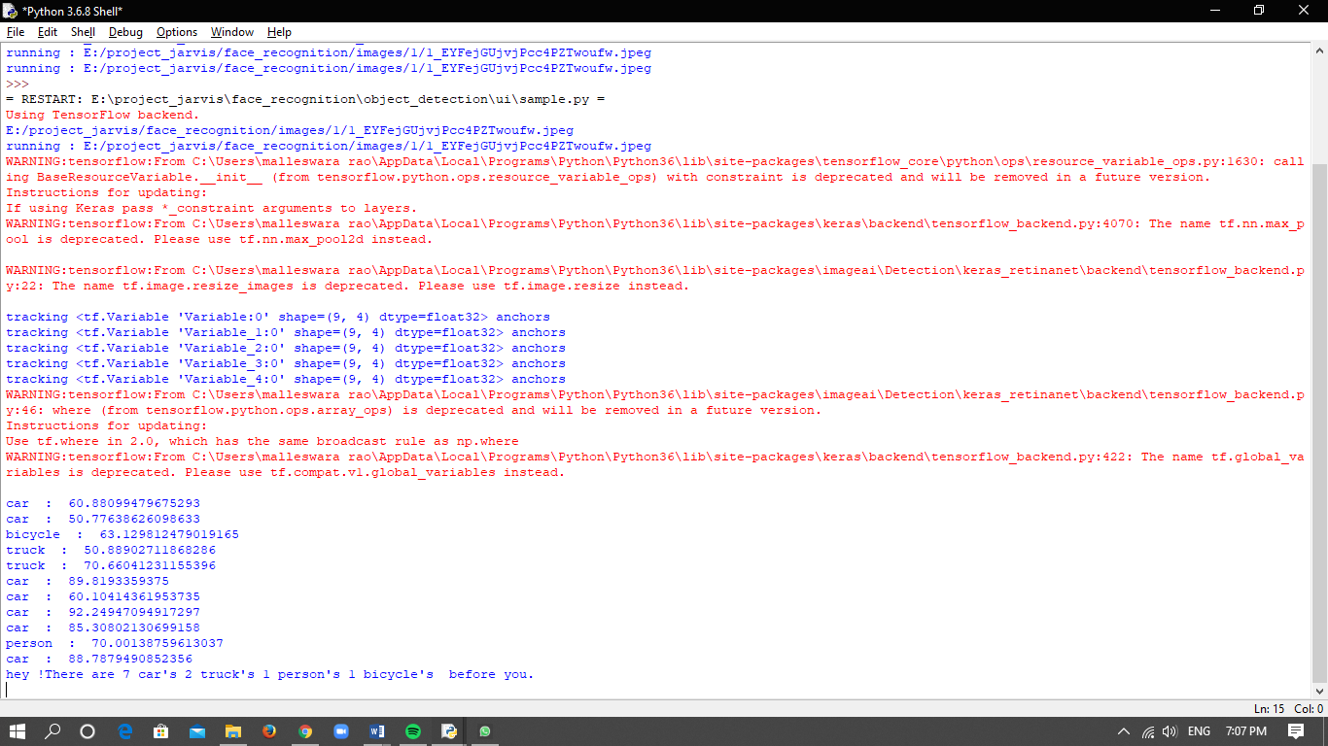
Running the Progamme
Notes:
This running of the Program things happen in the backend in any Python compiler like IDLE python or PYCHARM

Slide 16
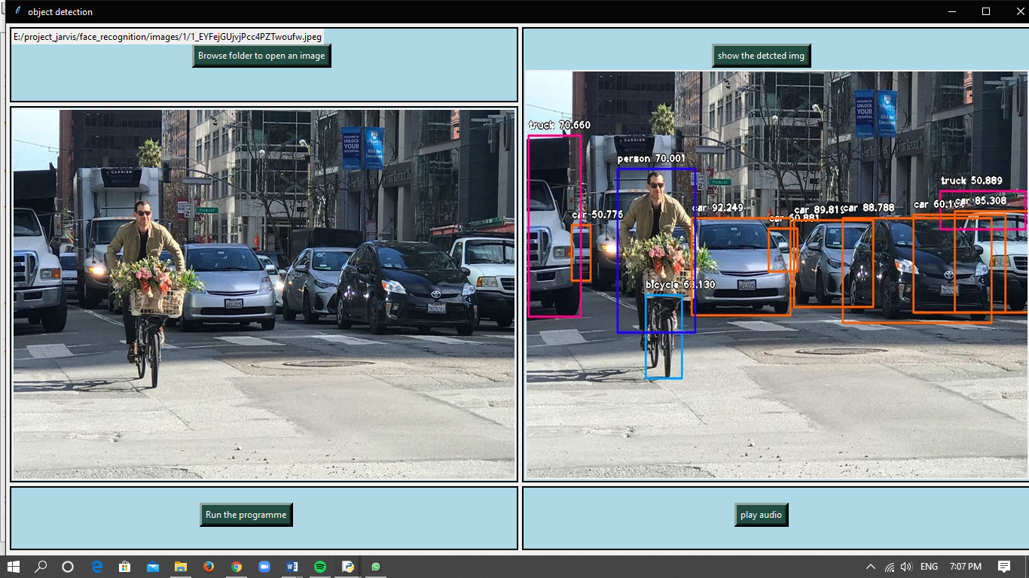
Displaying the Result ( Detected Image with bounding boxes)

Slide 17
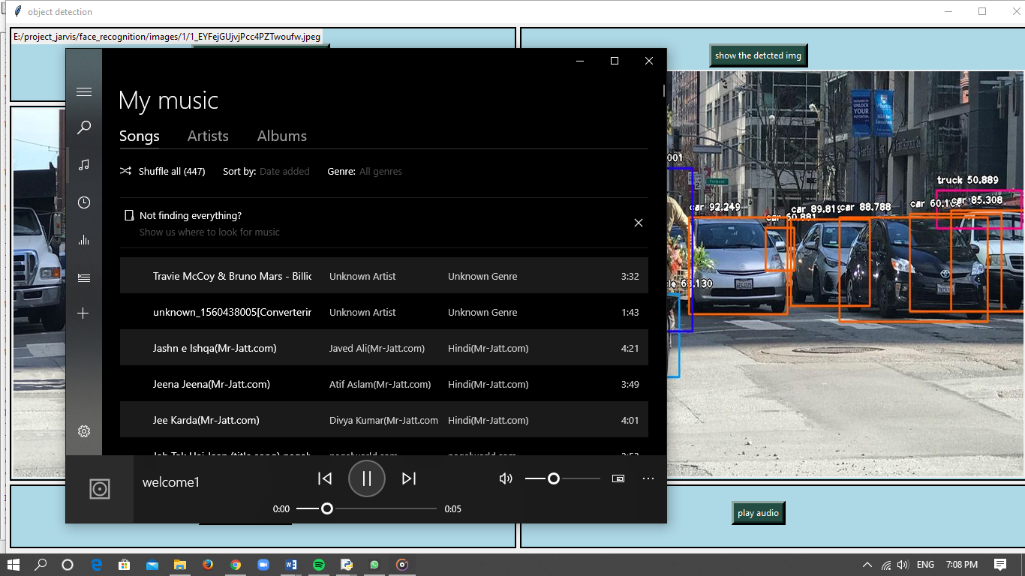
Playing the AUDIO output

Slide 18
Mapping of PO’s
DRC-1
 | PO1 (Engineering knowledge) | PO2 (Problem analysis) | PO3 (Design/ development of solution) | PO4 (CIOCP) | PO5 (Modern tool usage) | PO6 (The engineer and society) | PO7 (Environment & sustainability) | PO8 (ethics) | PO9 (Individual and team work) | PO10 (Communication) | PO11 (Project management and finance) | PO12 (Life long learning )
CO1 | 3 | 3 | 3 | - | 2 | 1 | - | - | 3 | - | - | 2
CO2 | - | 2 | 3 | - | - | - | - | - | - | - | - | -
CO3 | - | - | 3 | - | 3 | - | - | - | - | - | - | -
PROGRAM SPECIFIC OUTCOMES
 | PSO1 | PSO2 | PSO3
CO1 | 2 | 3 | -
CO2 | 2 | 2 | 2
CO3 | 1 | 2 | 3
WE WILL BE SUBMITTING THE FINAL DOCUMENTATION WORK AT INTERNATIONAL CONFERENCE IN THE MONTH OF MARCH 2020.
DEPARTMENT OF CSE

Slide 19
Structured Abstract
DRC-1
PURPOSE: Helping the Visually impaired people.
OBJECTIVE: To get more accuracy than existing system.
METHODOLOGY: The methodology consists of the following sequence of steps:
PROBLEM FINDING : Ashish , Varma
LITERATURE REVIEW : Ramesh, Ashish
GATHERING OF REQUIREMENTS: Varma, Praveen
BUILDING MODEL FOR PROPOSED WORK : Varma, Ashish, Ramesh
IMPLEMENTATION, TESTING, RESULTS AND ANALYSIS : Ashish, Praveen,Varma
THESIS PREPARATION AND SUBMISSION – Praveen, Ramesh
FINDINGS:
PRACTICAL IMPLICATIONS:
DEPARTMENT OF CSE

